Slide 1
SYSTEM ANALYSIS AND DESIGN
GOAL :
Help students understand how a system is designed in a systematic and phased manner, starting from:
Planning
requirement analysis
Design
system implementation
maintenance.
Notes:
The key to success in business is the ability to gather, organize, and interpret information. Systems analysis and design is a proven approach that helps both large and small businesses reap the rewards of utilizing information to its full capacity to generate value for the organization. As a systems analyst, the person in the organization most involved with systems analysis and design, you will enjoy a rich career path that will enhance both your computer and interpersonal skills.
What is Systems Analysis and Design: The complex organizational process whereby computer-based information systems are developed and maintained
Application Software : Computer software designed to support organizational functions or processes
Systems analyst
The organizational role most responsible for the analysis and design of information systems.
The main goal of systems analysis and design is to improve organizational systems, typically through applying software that can help employees accomplish key business tasks more easily and efficiently. As a systems analyst, you will be at the center of developing this software. The analysis and design of information systems are based on:
Your understanding of the organization’s objectives, structure, and processes
Your knowledge of how to exploit information technology for advantage

Slide 2
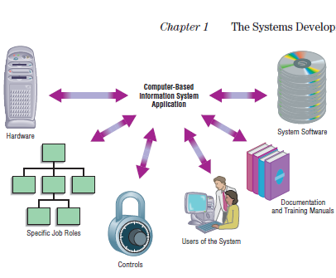
Concepts
Notes:
The major goal of systems analysis and design is to improve organizational systems. Often this process involves developing or acquiring application software and training employees to use it. Application software, also called a system, is designed to support a specific organizational function or process.
Examples: as inventory management, payroll, or market analysis.
The goal of application software is to turn data into information. For example, software developed for the inventory department at a bookstore may keep track of the number of books in stock of the latest best seller. Software for the payroll department may keep track of the changing pay rates of employees.
In addition to application software, the information system includes:
The hardware and systems software on which the application software runs. Note that the systems software helps the computer function, whereas the application software helps the user perform tasks such as writing a paper, preparing a spreadsheet, and linking to the Internet.
Documentation and training materials, are materials created by the systems analyst to help employees use the software they’ve helped
create.
The specific job roles associated with the overall system, such as the people who run the computers and keep the software operating.
Controls, which are parts of the software written to help prevent fraud and theft.
The people who use the software in order to do their jobs.

Slide 3
Concepts:
Methodologies are a sequence of step-by-step approaches that help develop your final product: the information system. Most methodologies incorporate several development techniques, such as direct observations and interviews with users of the current system
Notes:
Our goal is to help you understand and follow the software engineering process that leads to the creation of information systems. As shown in Figure 1-3, proven
methodologies, techniques, and tools are central to software engineering processes (and to this book).

Slide 4
Concepts
Techniques are processes that you, as an analyst, will follow to help ensure that your work is well thought-out, complete, and comprehensible to others on your project team. Techniques provide support for the tasks, such as: conducting thorough interviews with current and future users of the information system to determine what your system should do, planning and managing the activities in a systems development project, diagramming how the system will function, and designing the reports, such as invoices, your system will generate for its users to perform their jobs.

Slide 5
Concepts
Tools are computer programs, such as computer-aided software engineering
(CASE) tools, that make it easy to use specific techniques. These three elements methodologies, techniques, and tools work together to form an organizational approach to systems analysis and design

Slide 6
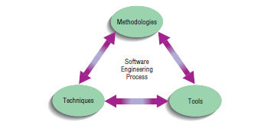

Slide 7
Systems development
It is a systematic process which includes phases such as
-planning,
analysis,
design,
deployment,
and maintenance
Notes:
It can be generally be thought of as having two major components: Systems analysis and Systems design

Slide 8
Systems Analysis
It is a process of collecting and interpreting facts, identifying the problems, and decomposition of a system into its components.
System analysis is conducted for the purpose of studying a system or its parts in order to identify its objectives. It is a problem solving technique that improves the system and ensures that all the components of the system work efficiently to accomplish their purpose.
Analysis specifies what the system should do.

Slide 9
Systems Design
It is a process of planning a new business system or replacing an existing system by defining its components or modules to satisfy the specific requirements. Before planning, you need to understand the old system thoroughly and determine how computers can best be used in order to operate efficiently.
System Design focuses on how to accomplish the objective of the system.
Notes:
Example:, The stockroom operation of a clothing store.
To control its inventory and gain access to current information about stock levels to facilitate
The reordering process to ensure the store does not run out of goods. A system analyst is tasked , to “computerize” the stockroom
operations.
Before one can design a system to capture data, update files, and produce
reports, one needs to know more about the store operations: what forms are being used to
store information manually, such as requisitions, purchase orders, and invoices and what
reports are being produced and how they are being used.
To proceed, you then seek out information about lists of reorder notices,
outstanding purchase orders, records of stock on hand, and other reports. You also need
to find out where this information originates, whether in the purchasing department,
stockroom, or accounting department. In other words, you must understand how the
existing system works and, more specifically, what the flow of information through the
system looks like.
You also must know why the store wants to change its current operations. Does
the business have problems tracking orders, merchandise, or money? Does it seem to fall
behind in handling inventory records? Does it need a more efficient system before it can
expand operations?
Only after you have collected these facts can you being to determine how and
where a computer information system can benefit all the users of the system. This
accumulation of information, called a systems study, must precede all other analysis
activities.

Slide 10
System Analysis and Design
System Analysis and Design (SAD) mainly focuses on −
Systems
Processes
Technology

Slide 11
What is a System?
The word System is derived from Greek word Systema, which means an organized relationship between any set of components to achieve some common cause or objective.
A system is “is an interrelated set of business procedures (or components) used within one business unit, working together for some purpose.”
Notes:
Examples:
A Payroll System: Keeps tracks of payments and cheques
Inventory System: Keeps track of goods and supplies

Slide 12
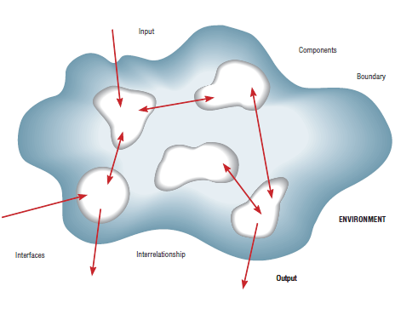
Definition of a System and its Parts

Slide 13
Properties of a System
A system has the following properties −
- Organization
Organization implies structure and order. It is the arrangement of components that helps to achieve predetermined objectives.
Interaction
It is defined by the manner in which the components operate with each other.
For example, in an organization, purchasing department must interact with production department and payroll with personnel department

Slide 14
Interdependence
Interdependence means how the components of a system depend on one another. For proper functioning, the components are coordinated and linked together according to a specified plan. The output of one subsystem is the required by other subsystem as input.
Integration
Integration is concerned with how a system components are connected together. It means that the parts of the system work together within the system even if each part performs a unique function.

Slide 15
Central Objective
The objective of system must be central. It may be real or stated. It is not uncommon for an organization to state an objective and operate to achieve another.
The users must know the main objective of a computer application early in the analysis for a successful design and conversion

Slide 16
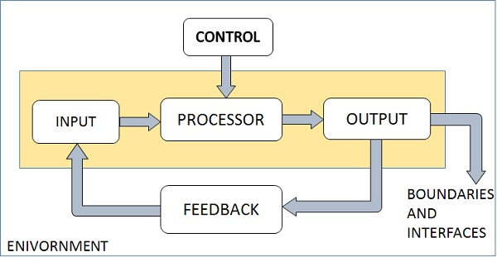
Elements of a System
The following diagram shows the elements of a system −

Slide 17
Outputs and Inputs
The main aim of a system is to produce an output which is useful for its user.
Inputs are the information that enters into the system for processing.
Output is the outcome of processing.

Slide 18
Processor(s)
The processor is the element of a system that involves the actual transformation of input into output.
It is the operational component of a system. Processors may modify the input either totally or partially, depending on the output specification.
As the output specifications change, so does the processing. In some cases, input is also modified to enable the processor for handling the transformation.

Slide 19
Control
The control element guides the system.
It is the decision–making subsystem that controls the pattern of activities governing input, processing, and output.
The behavior of a computer System is controlled by the Operating System and software. In order to keep system in balance, what and how much input is needed is determined by Output Specifications.

Slide 20
Feedback
Feedback provides the control in a dynamic system.
Positive feedback is routine in nature that encourages the performance of the system.
Negative feedback is informational in nature that provides the controller with information for action.

Slide 21
Environment
The environment is the “supersystem” within which an organization operates.
It is the source of external elements that strike on the system.
It determines how a system must function. For example, vendors and competitors of organization’s environment, may provide constraints that affect the actual performance of the business.

Slide 22
Boundaries and Interface
A system should be defined by its boundaries. Boundaries are the limits that identify its components, processes, and interrelationship when it interfaces with another system.
Each system has boundaries that determine its sphere of influence and control.
The knowledge of the boundaries of a given system is crucial in determining the nature of its interface with other systems for successful design.

Slide 23
Types of Systems
The systems can be divided into the following types

Slide 24
Physical or Abstract Systems
Physical systems are tangible entities. We can touch and feel them.
Physical System may be static or dynamic in nature. For example, desks and chairs are the physical parts of computer center which are static. A programmed computer is a dynamic system in which programs, data, and applications can change according to the user's needs.
Abstract systems are non-physical entities or conceptual that may be formulas, representation or model of a real system.

Slide 25
Open or Closed Systems
An open system must interact with its environment. It receives inputs from and delivers outputs to the outside of the system. For example, an information system which must adapt to the changing environmental conditions.
A closed system does not interact with its environment. It is isolated from environmental influences. A completely closed system is rare in reality.

Slide 26
Adaptive and Non Adaptive System
Adaptive System responds to the change in the environment in a way to improve their performance and to survive. For example, human beings, animals.
Non Adaptive System is the system which does not respond to the environment. For example, machines.

Slide 27
Permanent or Temporary System
Permanent System persists for long time. For example, business policies.
Temporary System is made for specified time and after that they are demolished. For example, A DJ system is set up for a program and it is dissembled after the program.

Slide 28
Natural and Manufactured System
Natural systems are created by the nature. For example, Solar system, seasonal system.
Manufactured System is the man-made system. For example, Rockets, dams, trains.

Slide 29
Deterministic or Probabilistic System
Deterministic system operates in a predictable manner and the interaction between system components is known with certainty. For example, two molecules of hydrogen and one molecule of oxygen makes water.
Probabilistic System shows uncertain behavior. The exact output is not known. For example, Weather forecasting, mail delivery.

Slide 30
Social, Human-Machine, Machine System
Social System is made up of people. For example, social clubs, societies.
In Human-Machine System, both human and machines are involved to perform a particular task. For example, Computer programming.
Machine System is where human interference is neglected. All the tasks are performed by the machine. For example, an autonomous robot.

Slide 31
Man–Made Information Systems
It is an interconnected set of information resources to manage data for particular organization, under Direct Management Control (DMC).
This system includes hardware, software, communication, data, and application for producing information according to the need of an organization.

Slide 32
Man-made information systems are divided into three types −
Formal Information System − It is based on the flow of information in the form of memos, instructions, etc., from top level to lower levels of management.
Informal Information System − This is employee based system which solves the day to day work related problems.
Computer Based System − This system is directly dependent on the computer for managing business applications. For example, automatic library system, railway reservation system, banking system, etc

